Slide 1
Unit 1 Day 10
TWO COLUMN PROOFS

Slide 2
Statements
The left column of a Two Column Proof are Statements of mathematical relationships that start with given information and conclude with the Statement being proved.

Slide 3
Reasons
The right column of a Two Column Proof are reasons for the mathematical relationship on the same line. The reasons are based on geometric definitions, properties, and theorems.
Properties of parallel lines and angles are given in the following slides.

Slide 12
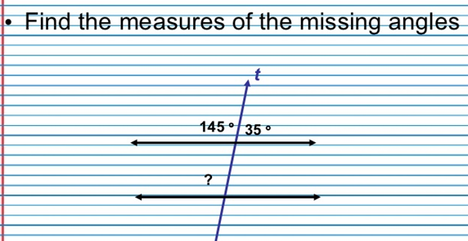

Slide 16
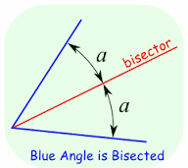
Definition of Angle Bisector
An Angle Bisector is a line that divides an Angle into two equal parts.

Slide 17
Transitive Property of Congruence
For any angles A, B, and C,
if ∠A≅∠B and ∠B≅∠C, then ∠A≅∠C .
If two angles are both congruent to a third angle, then the first two angles are also congruent.

Slide 18
See Mr. H’s Two Column Proofs

