Slide 1
Unit 2 Day 12 Quadrilaterals Proof

Slide 2
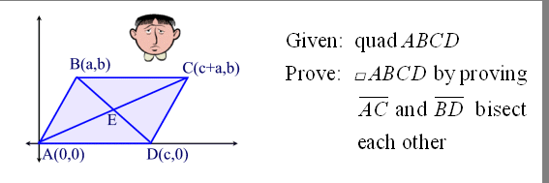
Example 1

Slide 3
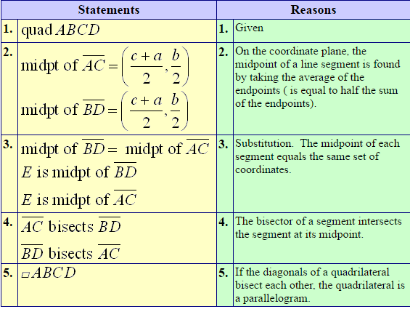
Example 1

Slide 4
Example2

Slide 5
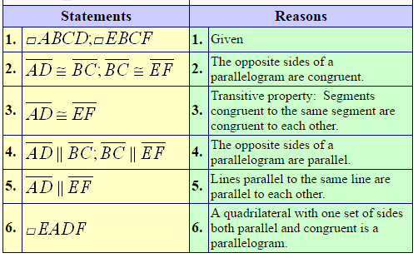
Example 2

Slide 6
Example 3

Slide 7
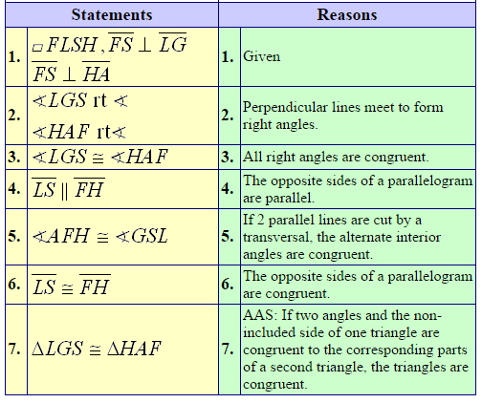
Example 3

Slide 8
Example 4

Slide 9
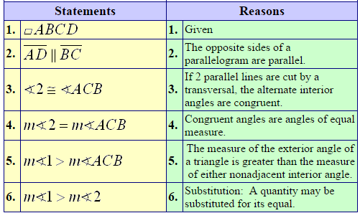
Example 4

Slide 10
Example 5

Slide 11
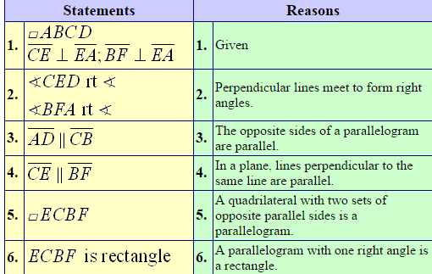
Example 5

Slide 12
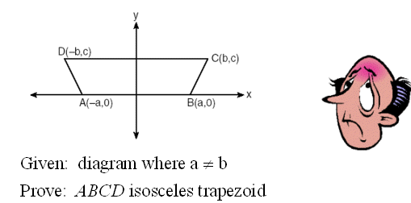
Example 6

Slide 13
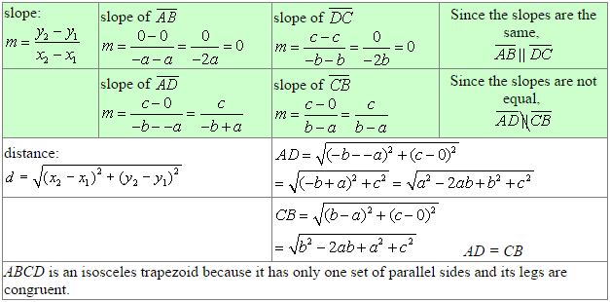
Example 6

Slide 14
Example 7:

Slide 15
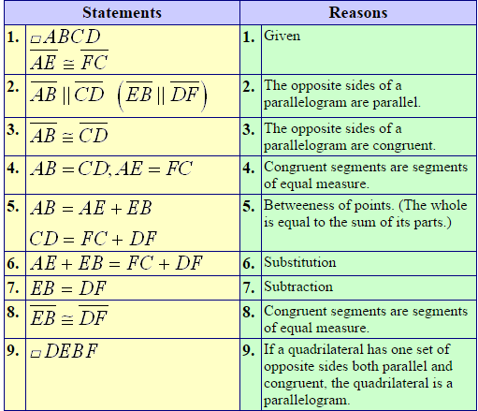
Example 7

Slide 16
Example 8

Slide 17
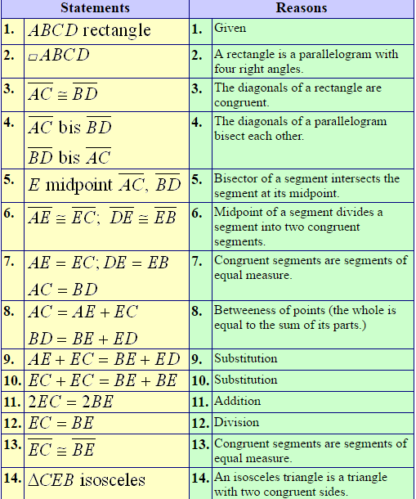
Example 8

