Slide 1
Polynomial graphs
Math 3 honors

Slide 2
Today…
Degree
Zeros (a.k.a. x-intercepts, solutions, roots)
Local Min/Max
End Behavior

Slide 3
“Warm up”
-8, 3, 6
$$\lim_{x→−∞}{−∞}$$
$$\lim_{x→∞}{∞}$$
3
3 because there are 3 zeros ( and/or 2 turning points)
(-8,0) (3,0) (6,0) (0,15)
$$y=.104x^{3}−.104x^{2}−5.625x+15$$

Slide 4
How many points to find line of best fit…
A Line?
A Parabola?
A Cubic?
A Quartic?
In General?
2
3
4
5
d+1

Slide 5




$$\lim_{x→−∞}{−∞}$$
$$\lim_{x→∞}{∞}$$
$$ℝ$$
$$ℝ$$
$$∅$$
$$\lim_{x→−∞}{∞}$$
$$\lim_{x→∞}{∞}$$
$$ℝ$$
$$[0,∞)$$
Min: $(0,0)$
$$\lim_{x→−∞}{−∞}$$
$$\lim_{x→∞}{∞}$$
$$ℝ$$
$$ℝ$$
$$∅$$
$$ℝ$$
$$[0,∞)$$
$$\lim_{x→−∞}{∞}$$
$$\lim_{x→∞}{∞}$$
Min: $(0,0)$
Odd Degree: same domain/range, mismatched ends, no abs. value Even Degree: different domain/range, same ends, 1 min/max value

Slide 6
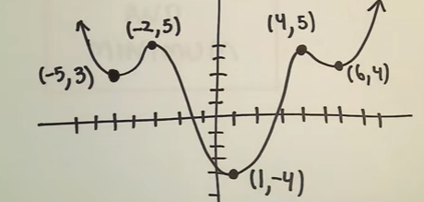
Local Max/Min
Example: Find local max/min points and absolute max and min for the given graph.
Local Min: (-5,3), (1,-4), (6,4)
Local Max: (-2,5), (4,5)
Absolute Min: (1,-4)
Absolute Max : none

Slide 7
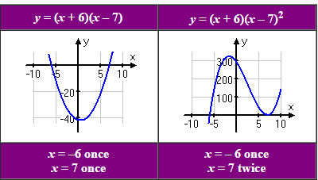
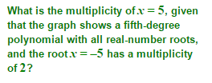
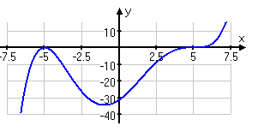
Multiplicity of Zeros (Factored Form)
A zero has a "multiplicity", which refers to the number of times that its associated factor appears in the polynomial.
Even multiplicity doesn’t change the factor sign, so it will touches and turn the x-axis
Odd multiplicity crosses the x- axis

Slide 8
Any # of algebraic expressions joined by a + or -
Set of all possible x-values
Set of all possible y-values
As x approaches + or - $∞$ , y approaches + or – $∞$ (use limit notation)
Greater or less than every other point
Greater or less than all points relative to it

Slide 9
Please Practice 4 problems
We will check answers in a bit…

Slide 10
In closing…
The lowest possible degree is determined by… the # of real zeros or the # of turning points +1 and the ends
Absolute Min/Max can occur only when… you have an even degree
Can you have two absolute Min/Max?... No, not absolute
The number of Local Min/Max can be… d-1 (turning points!)
End behavior is determined by… even/odd degree and LC

Slide 11
Please complete the exit ticket
Don’t forget your name! Put it in the warm up folder when you are finished.

