Slide 1
Class Discussion on Sampling
Unit 1 Day 1
Sampling

Slide 2
Discussion Question
How do we find the average of a set of numbers?
Find the average height of the students in this class

Slide 3
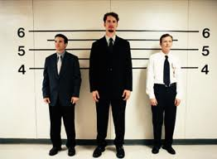
Discuss
What if I chose to average the height of just the males in this class? Would that represent the approximate heights of the students in the class?

Slide 4
Warm-Up
Do you think the average height of this class is the average height of PCHS student body?
Why or why not?
What if we wanted to approximate the height of the PCHS student body. How could I choose a good sample of students?

Slide 5
Discuss
I want to ‘approximate’ the height of the students in the class, by taking a sample. What are some ways I could choose a sample?
What if we wanted to approximate the height of the PCHS student body. How could I choose a good sample of students?

Slide 6
Watch this video (click the word)
Sampling
https://www.youtube.com/watch?v=ZoBFgd2X_ew

Slide 7
“Random” Sampling
A sampling method in which all members of a group (population) have an equal and independent chance of being selected.

Slide 10
The researcher divides the population into different subgroups (or strata) and then randomly selects the final subjects proportionally from each subgroup/strata.

Slide 11
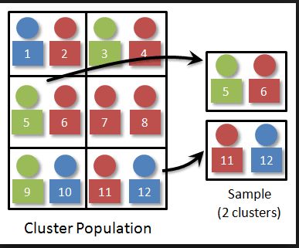

Slide 12
Stratified Sample or Cluster Sample?
Stratified:
1) Divide into strata (groups)
2) Randomly Select SOME people from EACH strata
Cluster:
1) Divide into clusters (groups)
2) Randomly Select SOME of the clusters
3) EACH person in EACH selected cluster is surveyed.

Slide 13
Voluntary Response Sample
People select themselves to be a part of the study.
Ex: call-in radio shows that ask you to call in about a topic.
The resulting sample tends to over represent individuals who have strong opinions…a biased sample can result.
THIS IS NOT A RANDOM SAMPLE!

Slide 14
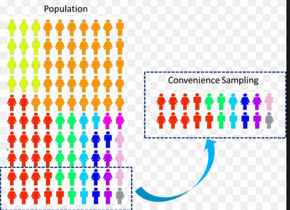
Ex: surveying 1st 20 people to walk into the movie theater on a Friday

Slide 15
Watch this video (click the word)
Sampling
https://www.youtube.com/watch?v=ZoBFgd2X_ew

Slide 16
1. Determine the type of sampling method used in each scenario.
a) The Ontario government randomly selects five high schools in Ontario and surveys each teacher in those schools.
Cluster

Slide 17
What is the best sampling technique to use for determining the average speed of the cars on a section of highway?
Simple random sample
Systematic sample
Convenience sample
A or B
D

Slide 18
Choose every 100th name from a telephone book
Systematic

Slide 19
Every 5th person boarding a plane is stopped and searched.
Systematic

Slide 20
At PCHS, five math classes on the third floor are chosen and each child in the class is surveyed.
Cluster

Slide 21
A researcher randomly selects 50 female and 50 male teachers in his study of technology in the classroom
Stratified

Slide 22
A researcher from an airline interviews all the passengers on flights traveling to the southeast
Cluster

Slide 23
c) Every twentieth family attending PCHS’ open house is surveyed.
Systematic

Slide 24
d) At a small community college, a student surveyed everyone in her biology class to determine the percentage of students who own a car.
Convenience

Slide 25
d) All of the teachers from schools in Fuquay-Varina are chosen for a survey.
Cluster

Slide 26
c) To avoid working late, a quality control specialist, checks the last 10 widgets manufactured.
Convenience

Slide 27
c) Based on 12,500 surveys received from 42,000 sent to alumni, UNC-CH determined the average salary of its alumni was $92,000.
Simple Random

Slide 28
c) A market researcher randomly selects 50 participants over 50 years and 50 participants less than 35 years.
Stratified

Slide 29
c) At Hope Chapel’s women’s brunch, each woman’s name is placed in a hat. Every 30 minutes a name is chosen.
Simple Random

Slide 30
d) Jonathon randomly selects three cards from a standard deck of cards.
Simple Random

Slide 31
Observational Study
Data is observed and collected on each subject
NO manipulation of the subjects’ environment occurs

Slide 32
Experimental Study
Manipulate the subjects’ environment, then…
Measure the response variable
A “TREATMENT” is IMPOSED

Slide 33
Survey
A questionnaire is used to get responses about the characteristics and/or attitudes of people
For example, asking students their opinion about extending the school day.

Slide 34
Experiment or Observational Study…does it make a difference?
An observational study may reveal
correlation between two variables
Only a randomized experiment can prove cause‐and‐effect

Slide 35
Experiment or Observational Study?
One study of video game use and the risk of brain cancer looked at a group of 342 people who have cancer. The investigators matched each brain cancer patient with a person of the same age, sex, and race who did not have brain cancer, then asked about the use of video games. Result: “Our data suggest that the use of video games is not associated with risk of brain cancer.”

Slide 36
Observational Study
There was no treatment imposed on one group

Slide 37
Experiment or Observational Study?
An educational software company wants to compare the effectiveness of its computer animation for teaching geography with that of a textbook presentation. The company gives a geography pretest to each of a group of middle school students, and then divides them into two groups. One group uses the animation, and the other studies the text. The company retests all students and compares the increase in geography test scores in the two groups.

Slide 38
Experiment…
One group used animation
Another group didn’t!
There was a control group.

Slide 39
HOMEWORK
DAY 3 HW

